Slide 1
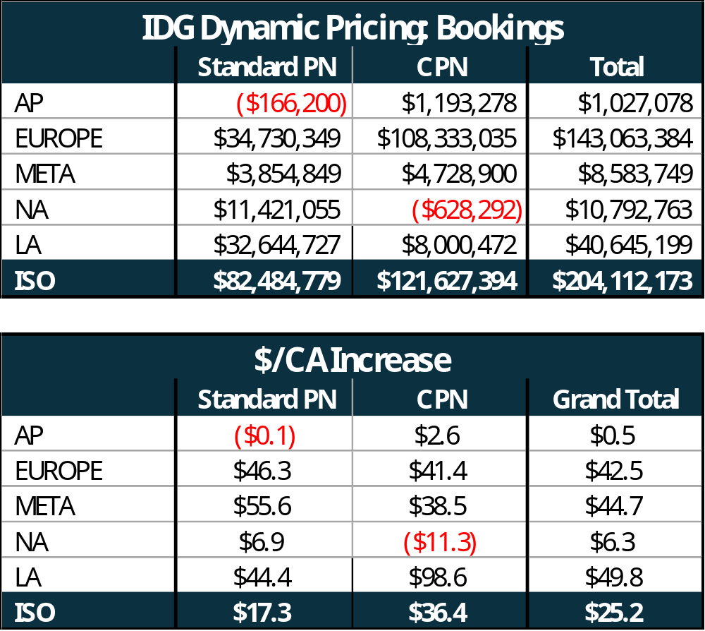
IDG Dynamic Pricing Business Case
Preliminary Finding:
Dynamic Pricing drives $80M-$204M incremental bookings ($17-$25/CA) benefit dependent on in-scope services
Benefit from Premier offering. Upgrades and Extension benefit immaterial at Dell target PR
AP Dell PR pricing results in lower Bookings due to Lenovo’s BM status in AP Geo. Adjusted to minimal increase
Scope:
Commercial Products (NB, DT, WS)
ESS Services (Premier + Upgrades & Extensions)
Standard & Custom PN
Assumptions:
FY25/26 ACT restated from ESS to Pen Rate pricing methodology
Using FY25/26 HW AUR → Higher $/CA expected with FY26/27 HW AUR
Japan & Brazil Dell PR targets normalized for full Geo PR targets
Not Included (SSG Pricing inputs required for inclusion)
HW Cannibalization
Attach rate reduction on high-ASP products
Attach rate increase on low-ASP products
Recommended Next Steps:
SSG Pricing review final business case with John S & Andrej

